Slide 1

7th Semester
Project Presentation
on
Future Mesh Enhancing Employability Through Mentorship and Smart Job Matching
Presented by
ABHISEK PANDA – 22UG010159
DEBABRATA MISHRA - 22UG010273
DIPTESH NARENDRA - 22UG010357
Under the guidance of
Dr. Gitanjali Mishra
Professor, Department of CSE, GIET University
Gandhi Institute of Engineering and Technology University
November 2023

Slide 2
Project Presentation on Future Mesh Enhancing Employability Through Mentorship and Smart Job Matching
OUTLINES
S.NO. | CONTENTS | PAGE NO.
1 | PROBLEM STATEMENT | 03
2 | INTRODUCTION | 04
3 | TECHNOLOGIES USED | 05
4 | NECESSARY DIAGRAMS | 06 – 13
5 | FEATURES | 14
6 | CHALLENGES | 15
7 | LIMITATIONS | 16
8 | SCREENSHOTS | 17
9 | CONCLUSION | 20
10 | FUTURE ENHANCEMENT | 21
11 | REFERENCES | 22

Slide 3
Project Presentation on Future Mesh Enhancing Employability Through Mentorship and Smart Job Matching
Problem Statement
Many students struggle to identify suitable career paths because of limited mentorship, lack of structured job guidance, and poor visibility of opportunities. Universities also face difficulties in managing job postings, shortlisting candidates, and tracking applications manually, while companies lack efficient ways to reach targeted candidates.
Real-World Importance
Career success depends on timely access to job opportunities, proper guidance, and alignment of student skills with industry needs.
A unified platform can reduce manual workload for placement cells, improve employability, and help companies hire faster with better filtering.

Slide 4
Project Presentation on Future Mesh Enhancing Employability Through Mentorship and Smart Job Matching
Introduction
FutureMesh is a digital platform designed to connect students, alumni, companies, HODs, and placement cells in a single system.
The project aims to remove the communication gaps present in traditional placement processes.
It provides features like mentorship chat, job postings, eligibility filtering, dashboards, and application tracking.
The system reduces the dependency on manual work and offers a structured, fast, and transparent placement workflow.
It helps students get guided mentorship, verified job opportunities, and a clear view of their progress.

Slide 5



Project Presentation on Future Mesh Enhancing Employability Through Mentorship and Smart Job Matching
Technology Stack
Frontend
Backend
React, Next.js
Nodejs
Database
Hosting
MongoDB Atlas
Vercel , Render

Slide 6
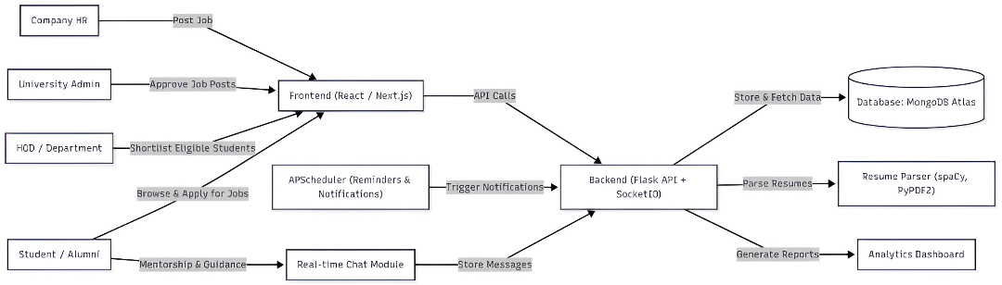
Project Presentation on Future Mesh Enhancing Employability Through Mentorship and Smart Job Matching
Overall Structure

Slide 7
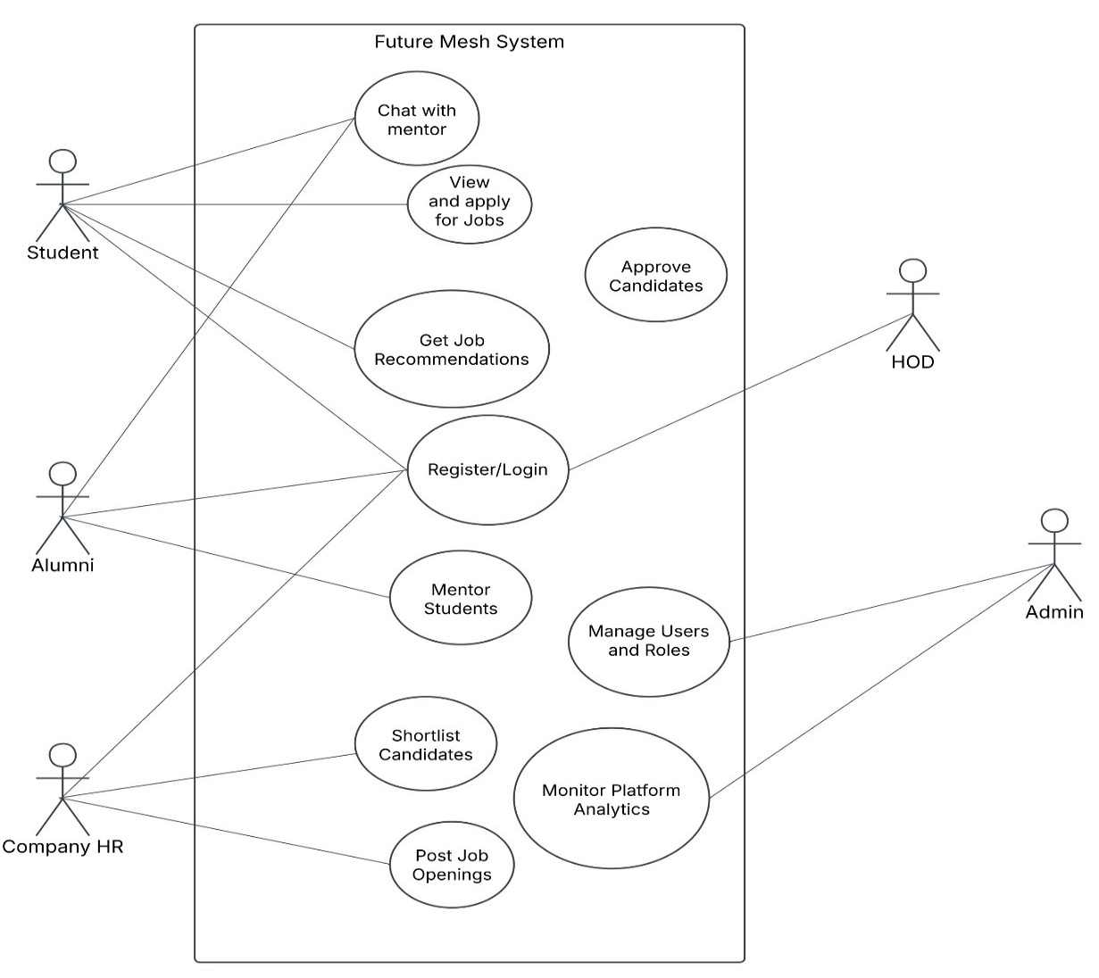
Project Presentation on Future Mesh Enhancing Employability Through Mentorship and Smart Job Matching
Use Case Diagram

Slide 8
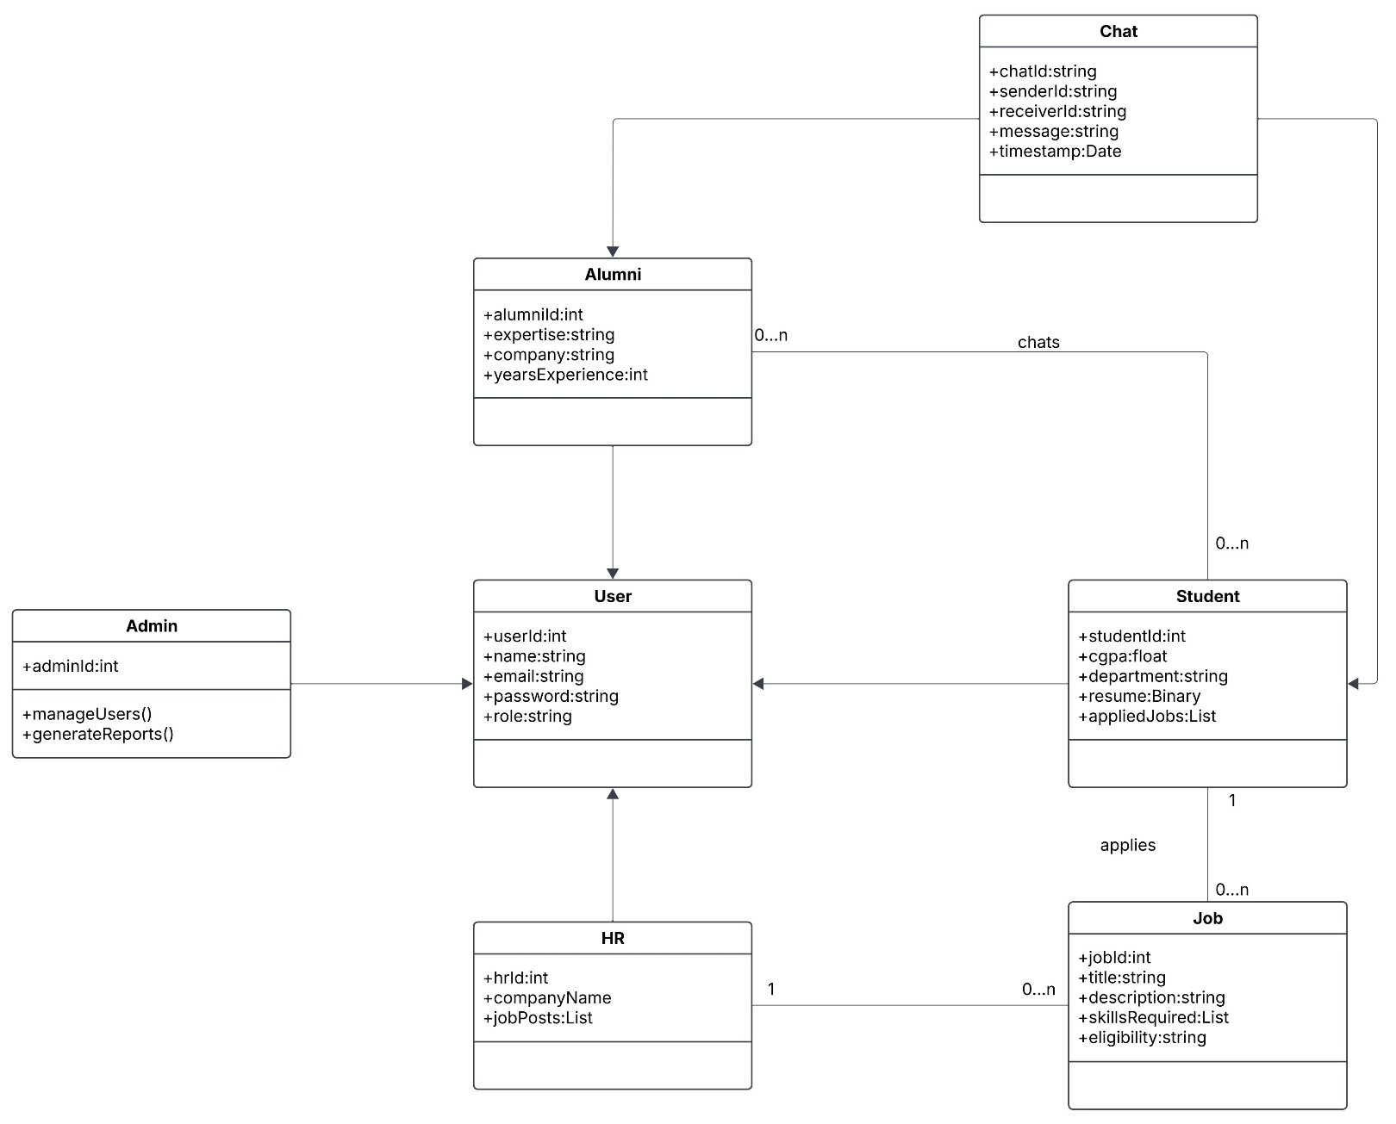
Project Presentation on Future Mesh Enhancing Employability Through Mentorship and Smart Job Matching
Class Diagram

Slide 9
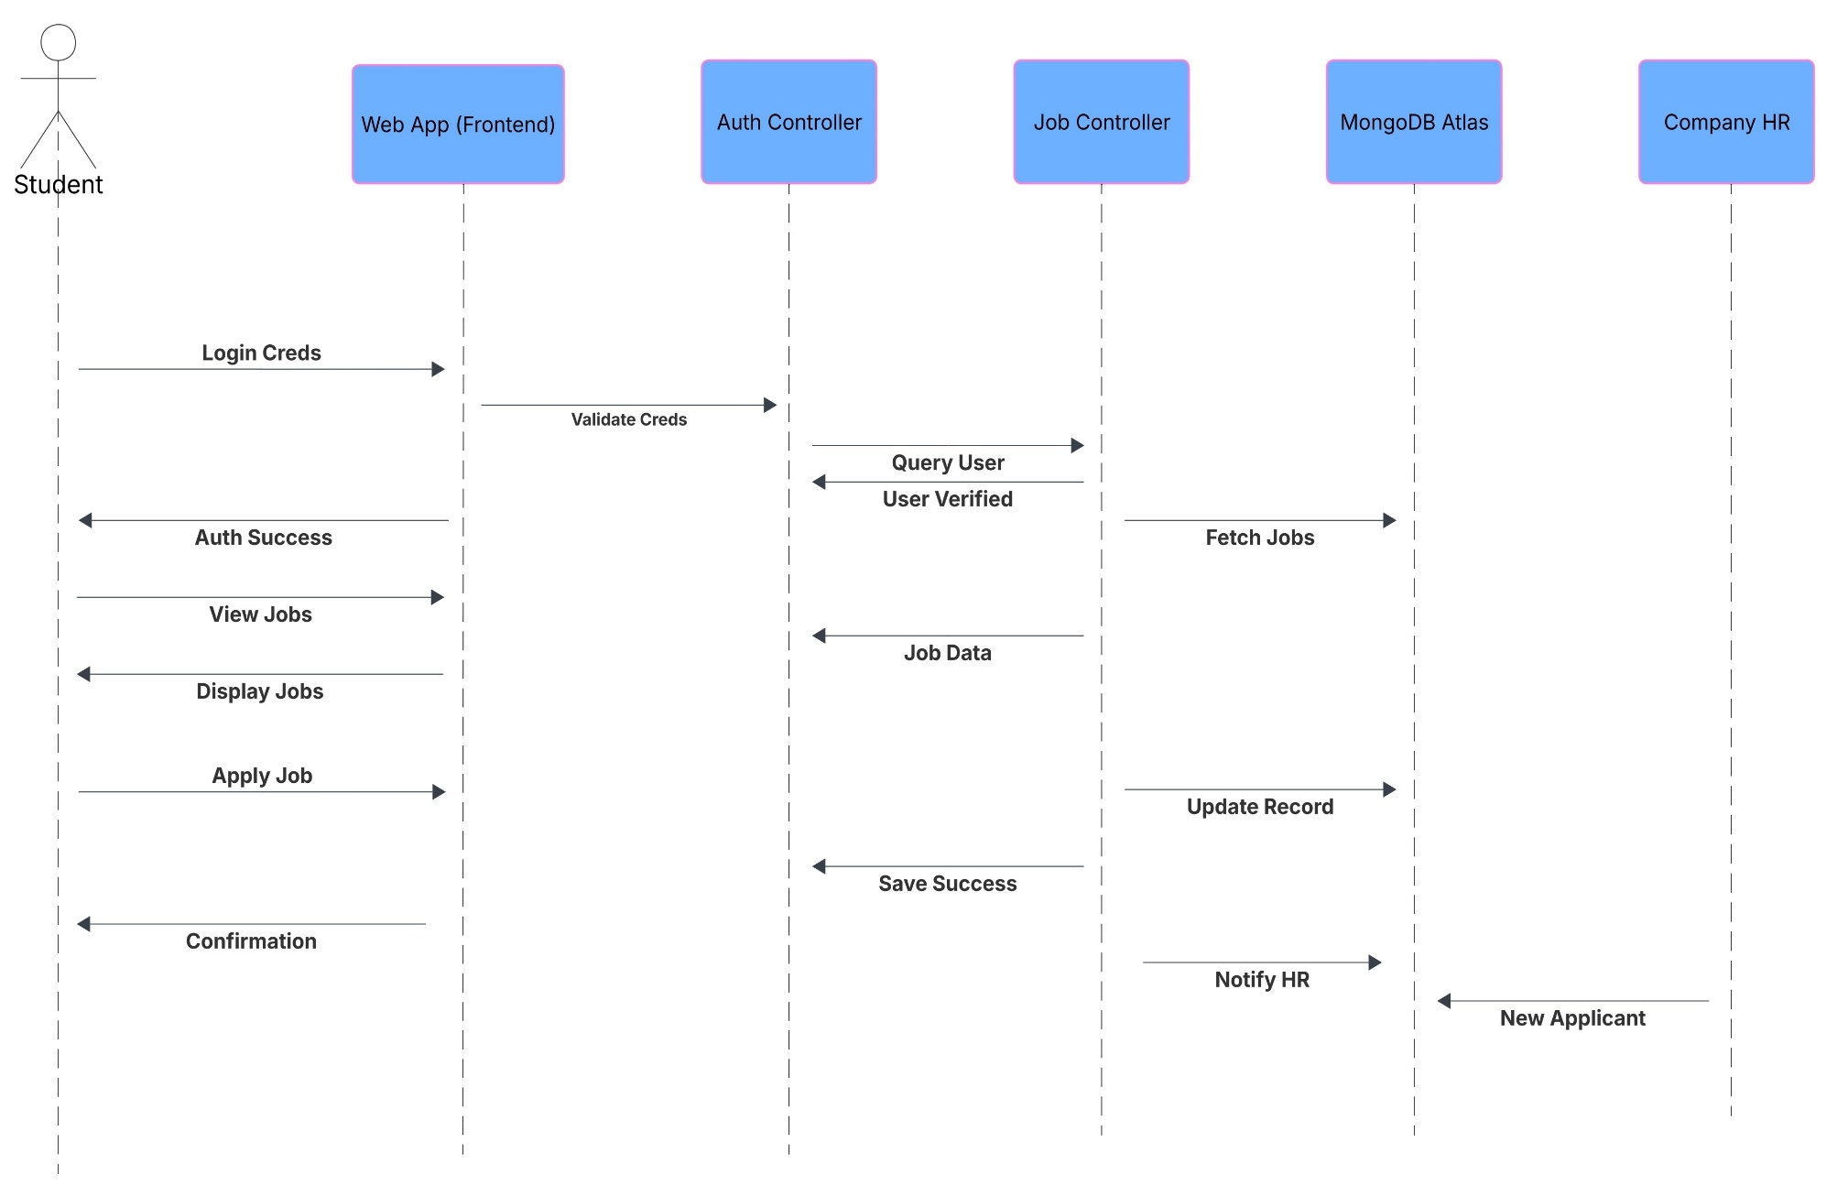
Project Presentation on Future Mesh Enhancing Employability Through Mentorship and Smart Job Matching
Sequence Diagram

Slide 10
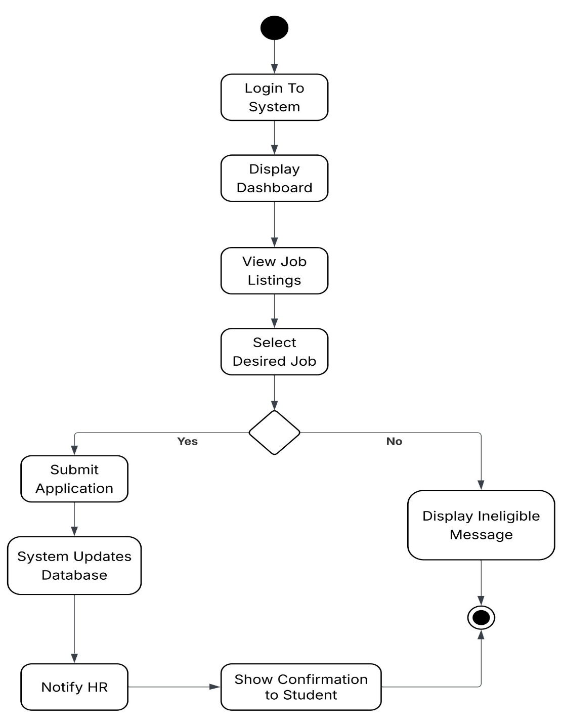
Project Presentation on Future Mesh Enhancing Employability Through Mentorship and Smart Job Matching
Activity Diagram

Slide 11
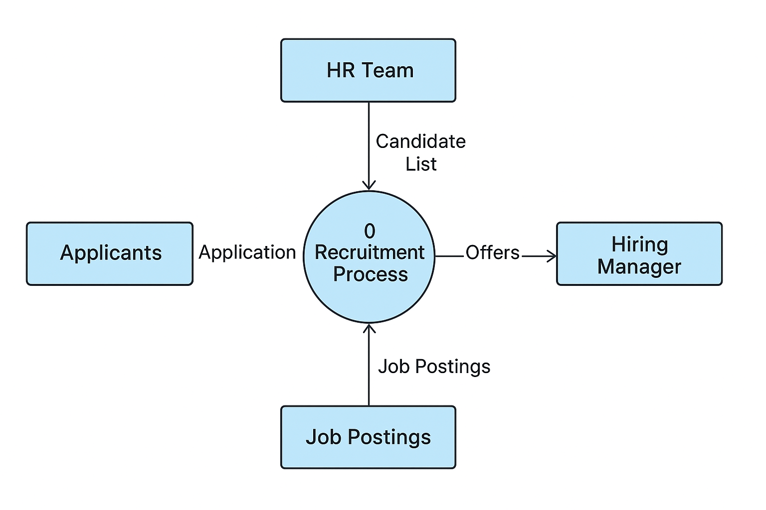
Project Presentation on Future Mesh Enhancing Employability Through Mentorship and Smart Job Matching
Data Flow Diagram (DFD)
Level-1

Slide 12
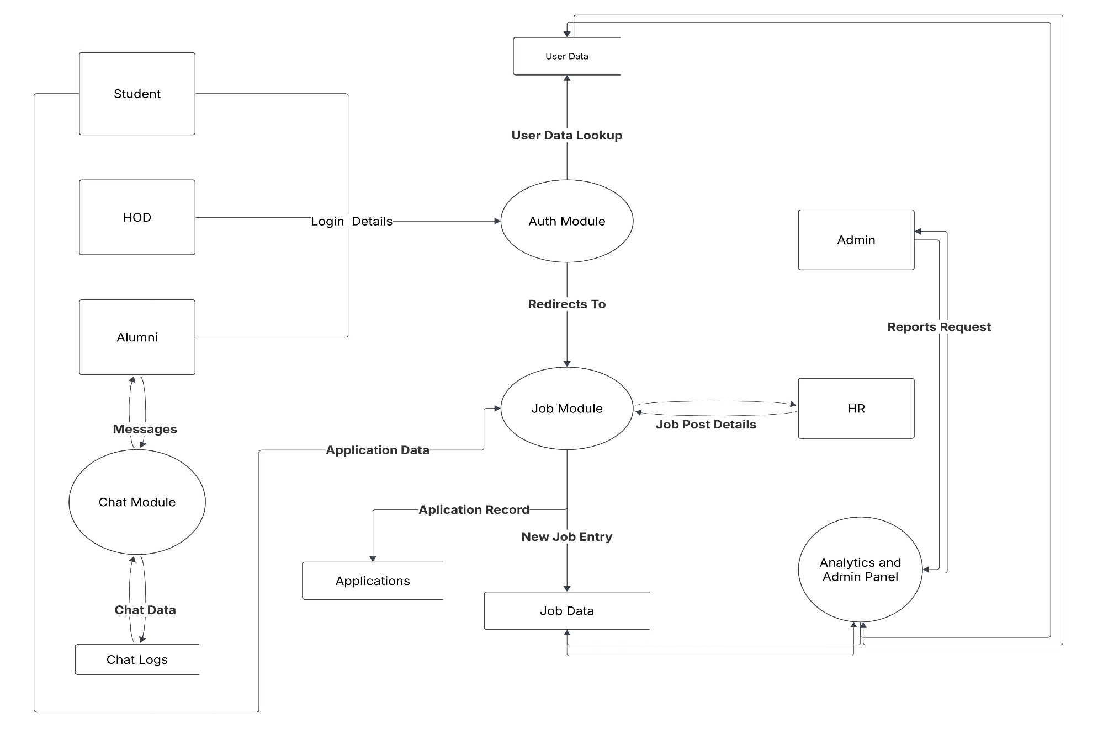
Project Presentation on Future Mesh Enhancing Employability Through Mentorship and Smart Job Matching
Data Flow Diagram (DFD)
Level-1

Slide 13
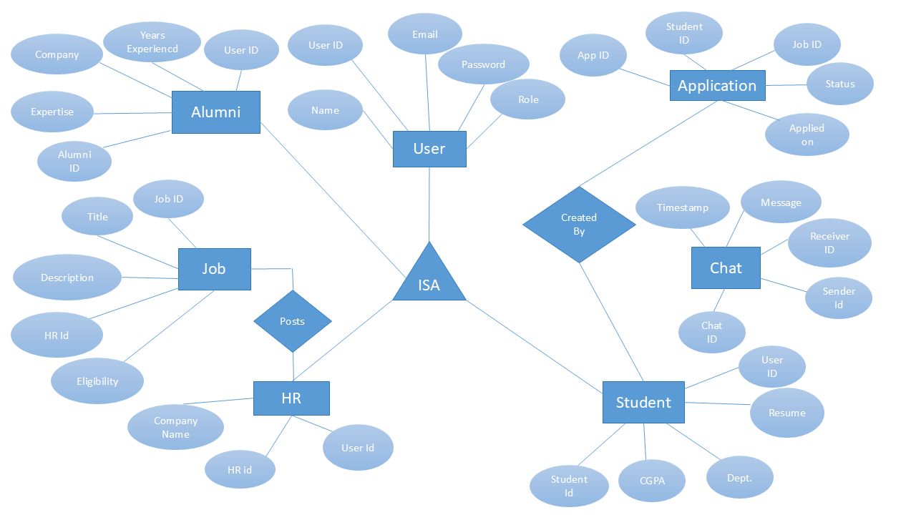
Project Presentation on Future Mesh Enhancing Employability Through Mentorship and Smart Job Matching
ER Diagram

Slide 14
Project Presentation on Future Mesh Enhancing Employability Through Mentorship and Smart Job Matching
Features
Unified platform: Brings students, alumni, companies, HODs, and placement cells into one organized system.
Role-based dashboards: Each user gets a separate dashboard based on their role and permissions.
Mentorship chat: Students can directly message alumni for guidance, career help, and doubts.
Job management: Companies can post jobs; admins approve; HODs shortlist students automatically based on criteria.
Application tracking: Students can see their job status like applied, shortlisted, rejected, or hired.
Student portfolio: Students can upload resumes, certificates, and project details.

Slide 15
Project Presentation on Future Mesh Enhancing Employability Through Mentorship and Smart Job Matching
Challenges
Handling multiple user roles: Designing access levels for students, alumni, and admin requires careful planning.
Real-time communication: Maintaining smooth mentorship chat without delay is technically challenging.
Module integration: Combining login, dashboards, job system, chat, and analytics without errors is complex.
User-friendly design: Creating dashboards that are simple yet professional for all users.
Data security: Protecting sensitive user information like resumes and academic records.

Slide 16
Project Presentation on Future Mesh Enhancing Employability Through Mentorship and Smart Job Matching
Limitations
Internet dependency: System cannot work offline; real-time features need stable connectivity.
Alumni availability: Effective mentorship depends on how actively alumni participate.
Server load issues: Chat and analytics may slow down if too many users are active at once.
Analytics not full-scale: Only basic insights available; advanced reports still to be added.

Slide 17
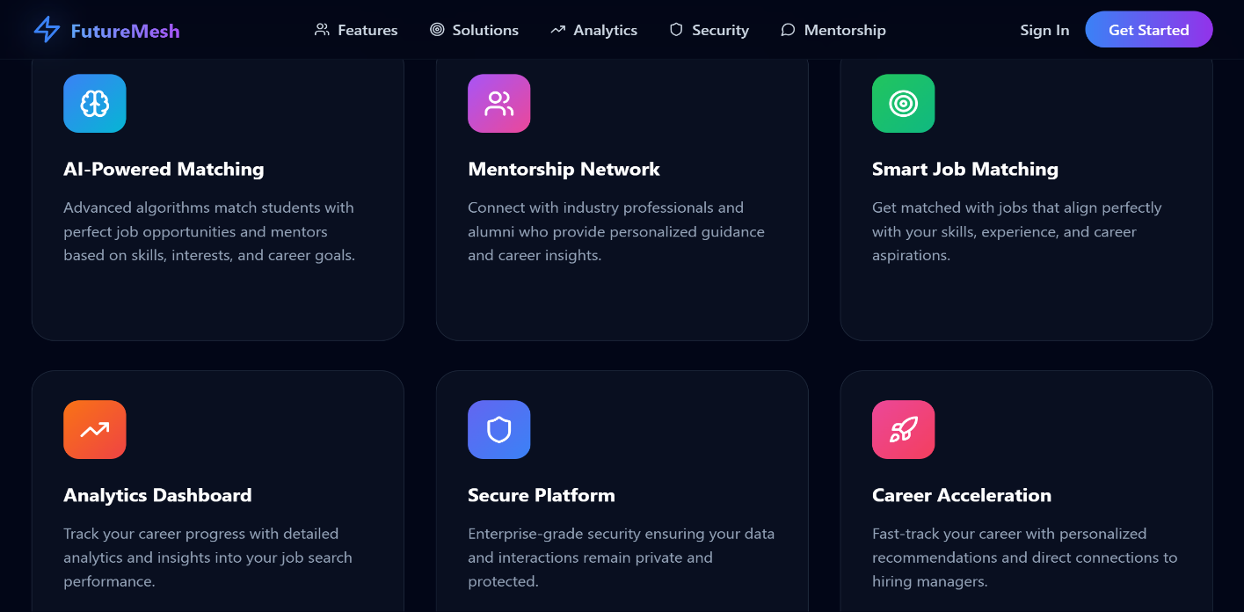
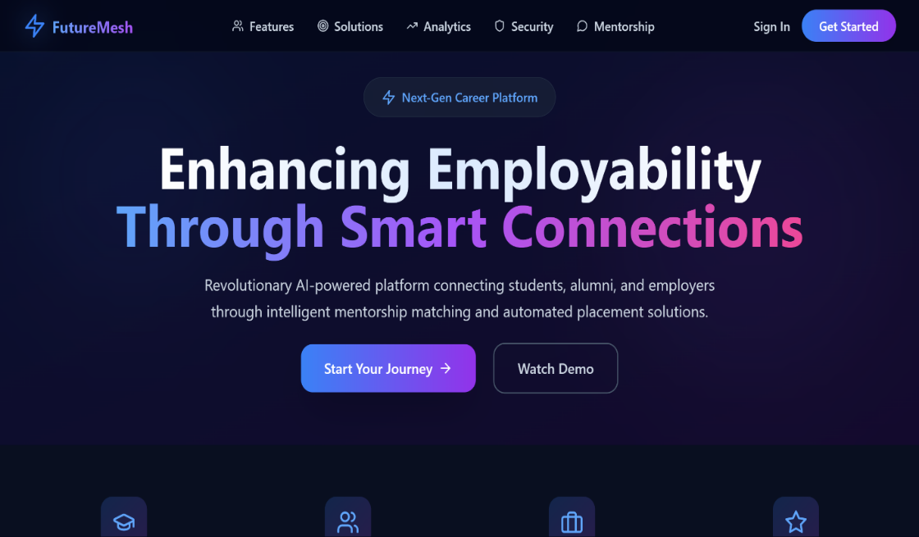
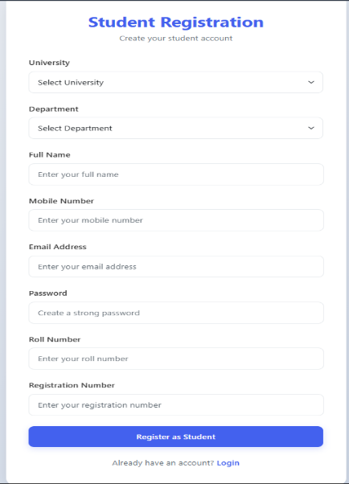
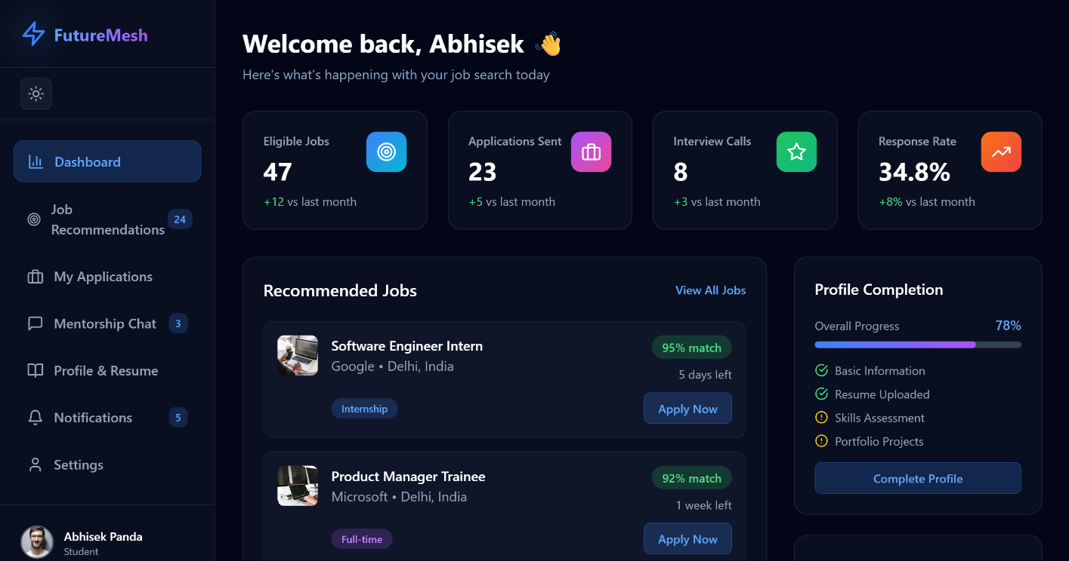
Project Presentation on Future Mesh Enhancing Employability Through Mentorship and Smart Job Matching
Screenshots

Slide 18
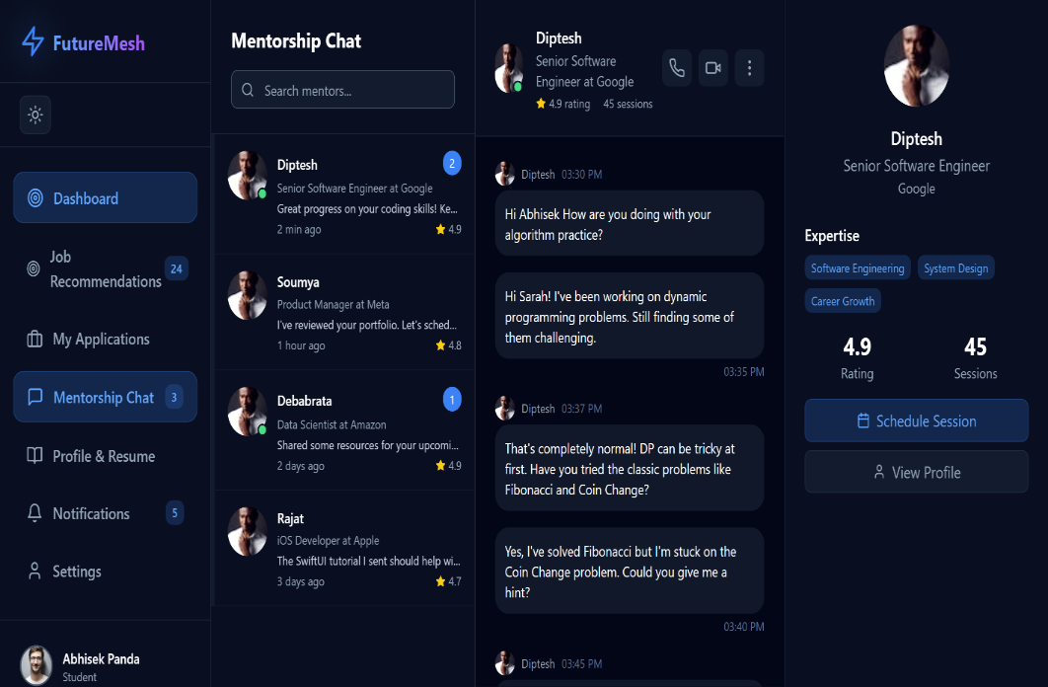
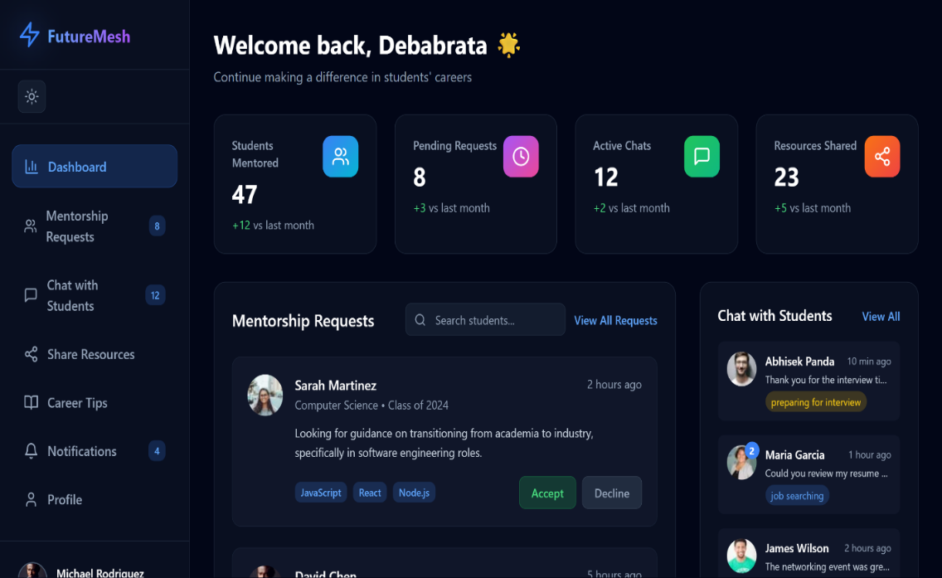
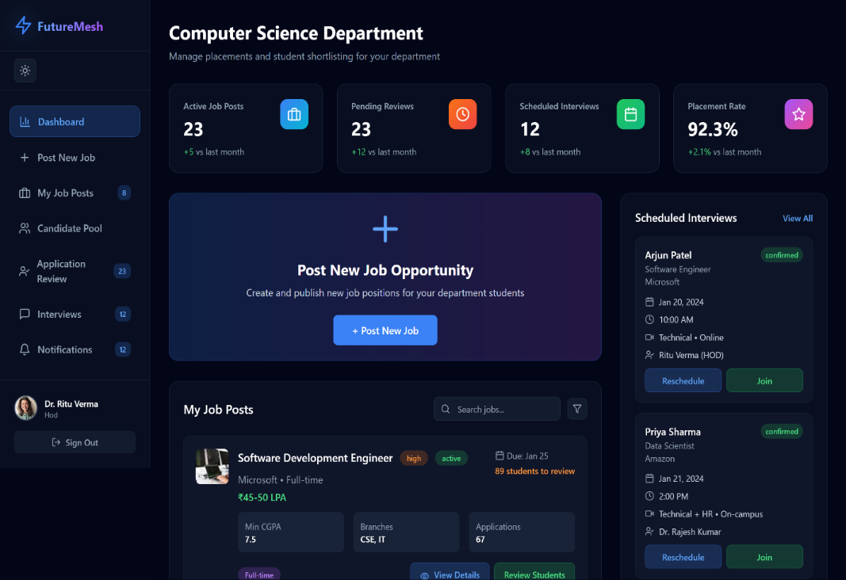
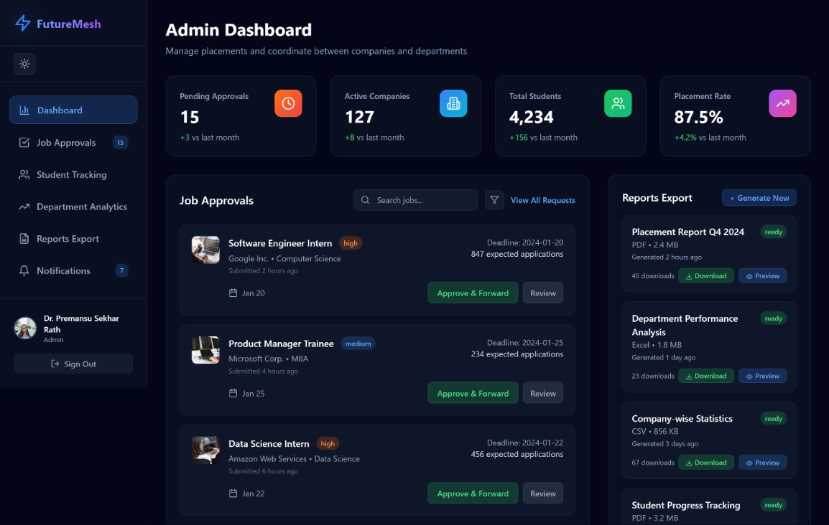
Project Presentation on Future Mesh Enhancing Employability Through Mentorship and Smart Job Matching

Slide 19
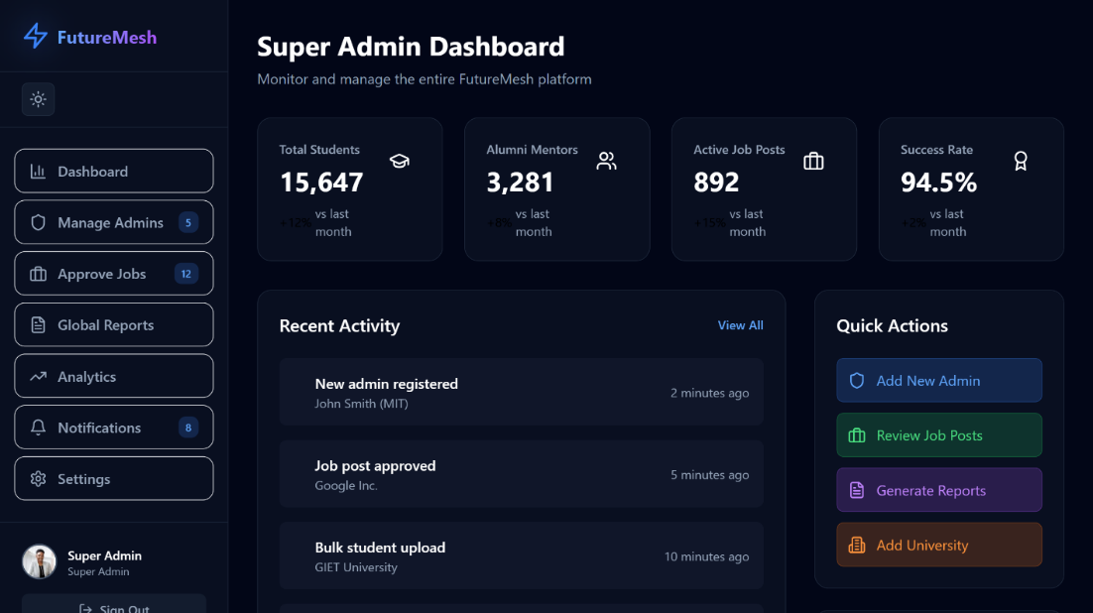
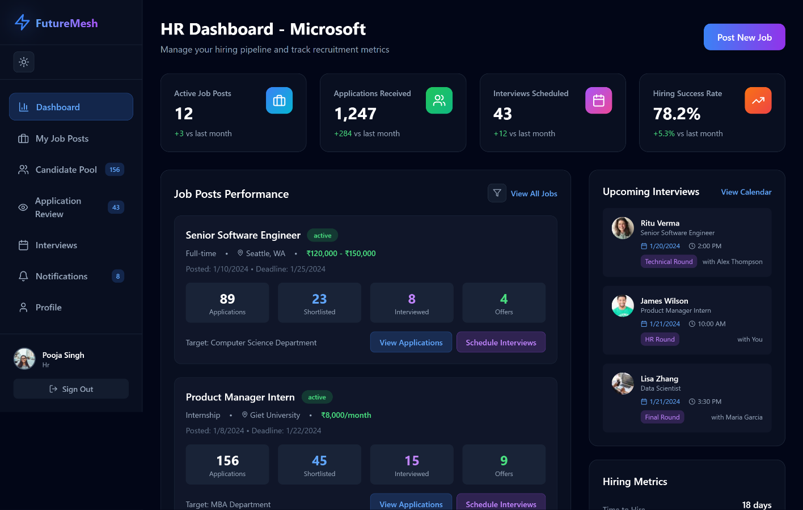
Project Presentation on Future Mesh Enhancing Employability Through Mentorship and Smart Job Matching

Slide 20
Project Presentation on Future Mesh Enhancing Employability Through Mentorship and Smart Job Matching
Conclusion
FutureMesh successfully connects all stakeholders in the placement ecosystem.
The platform reduces communication gaps, avoids manual errors, and makes placement activities easier.
Students gain genuine opportunities and personalized guidance from alumni.
The system modernizes placement processes with automated shortlisting, dashboards, and analytics.
It creates a structured digital environment that improves employability and institutional efficiency.

Slide 21
Project Presentation on Future Mesh Enhancing Employability Through Mentorship and Smart Job Matching
Future Enhancements
AI job recommendations: Suggest jobs automatically based on student profile and skills.
Resume screening: NLP-based evaluation to match resumes with job roles.
Video & Chat interview module: Built-in scheduling, calling, and recording.
Skill-gap analysis: Helps students understand where improvement is needed.
Industry integration: API links with LinkedIn, Naukri, and HR systems.

Slide 22
Project Presentation on Future Mesh Enhancing Employability Through Mentorship and Smart Job Matching
References
Smart India Hackathon (SIH1630) official problem statement.
MongoDB Atlas documentation for database design.
React, Next.js, TypeScript official developer guides.
Vercel hosting documentation for deployment.
Standard software engineering and web development documentation.

Slide 23

Project Presentation on Future Mesh Enhancing Employability Through Mentorship and Smart Job Matching

